Slide 1
History of Computer Science

Slide 2
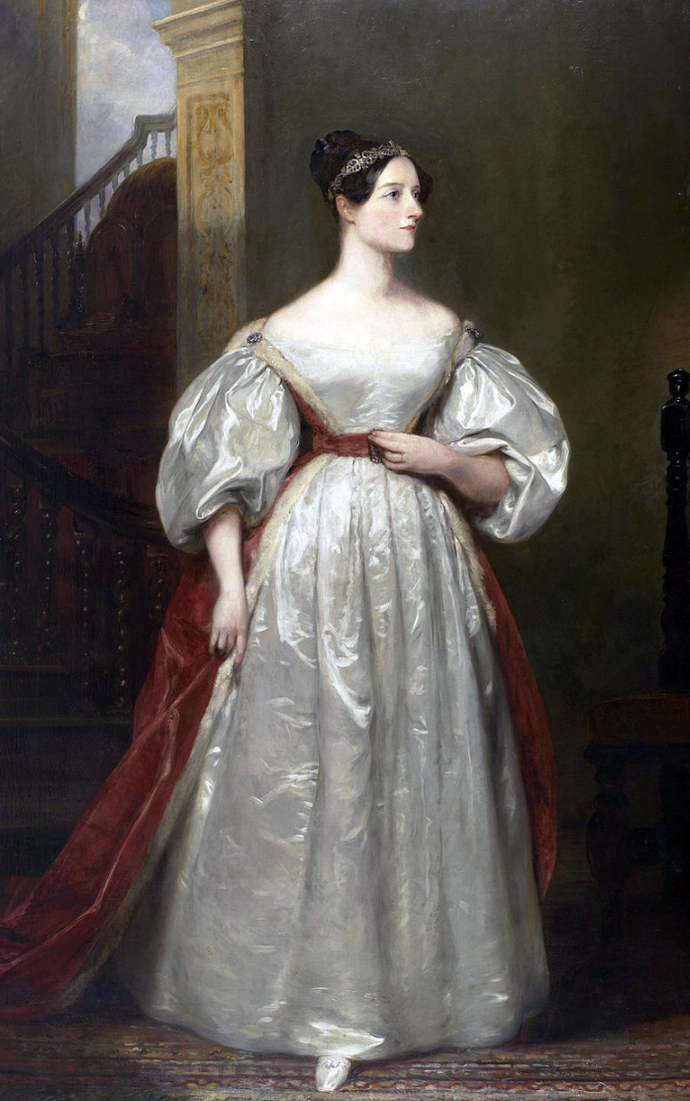
1842
Ada Lovelace invented the first computer algorithm based on the theory of punch cards by Charles Babbage.

Slide 3
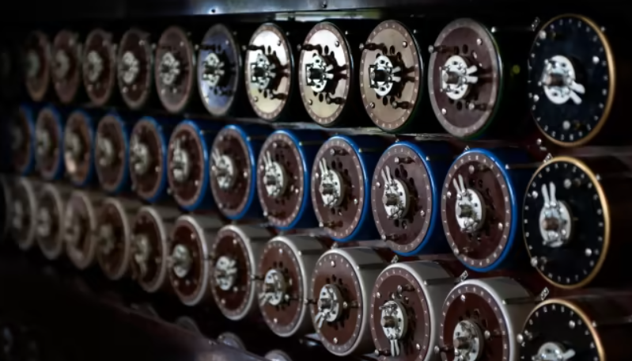
1936
Alan Turing formalized the turing machine. Which can compute everything that is computable.

Slide 4
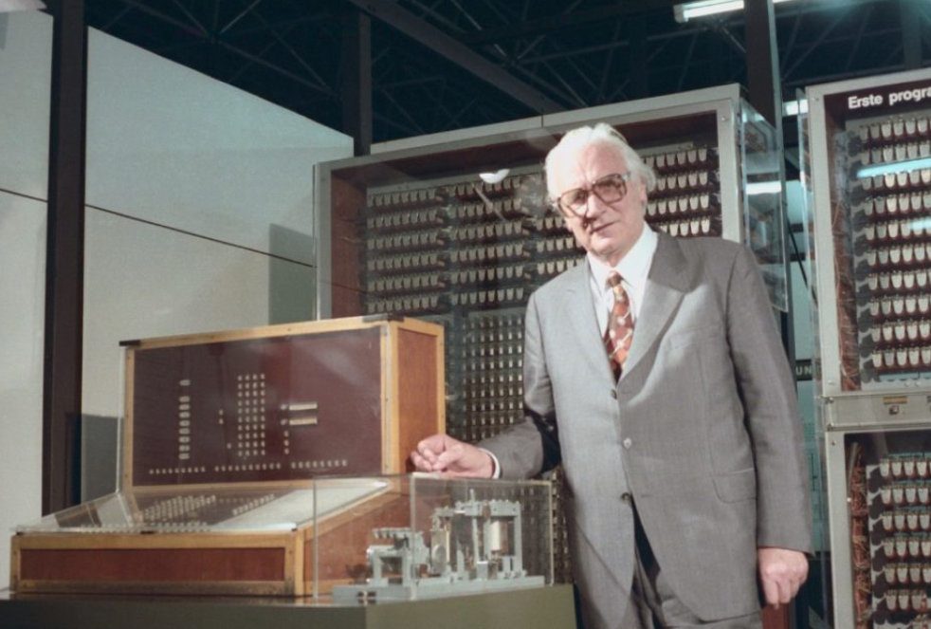
1941
Konrad Zuse designed the world‘s first programmable digital computer. The code was stored on a punched film.

Slide 5
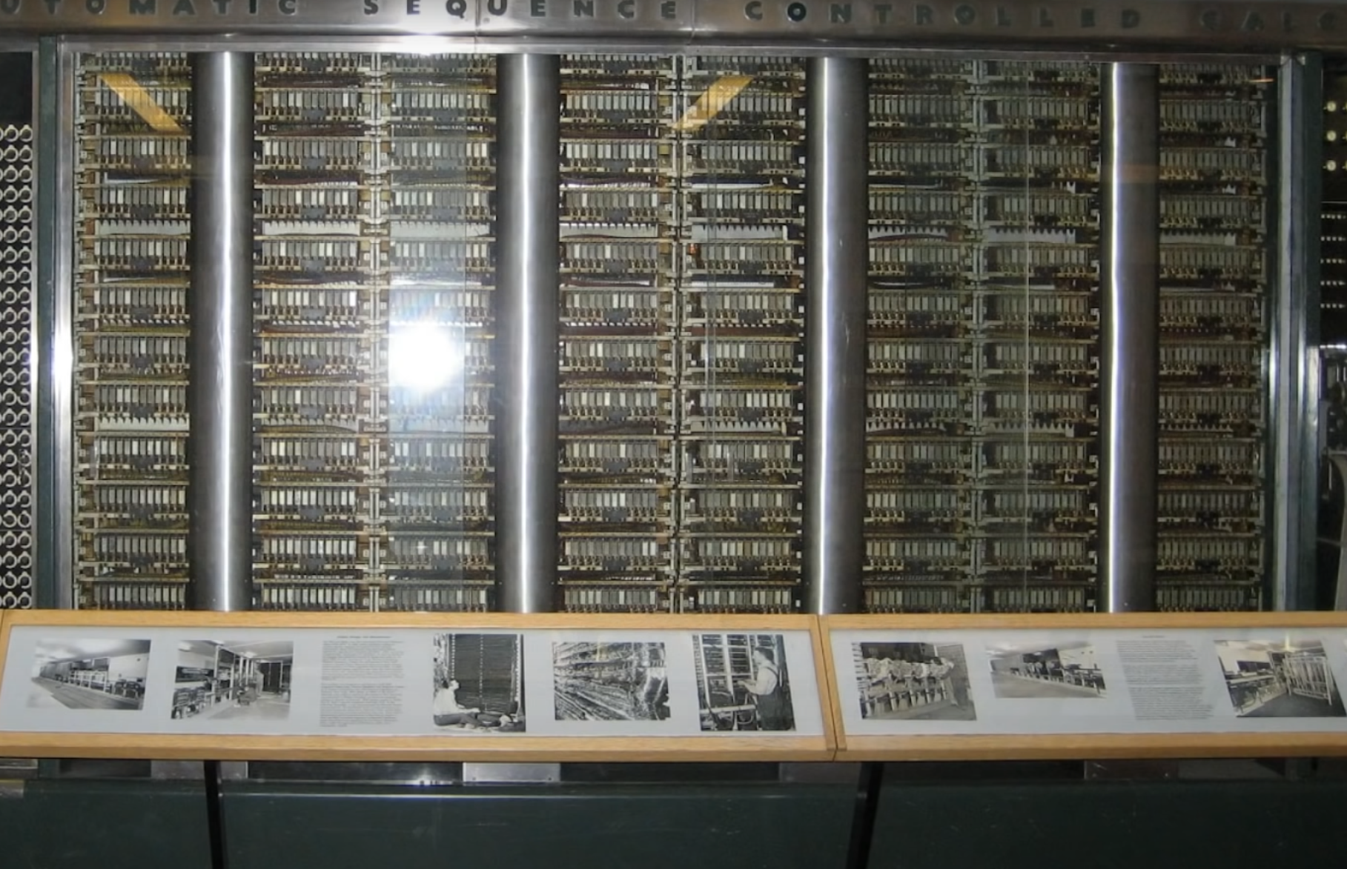
1943
Howark Aiken was working on the Mark 1 in the US.

Slide 6
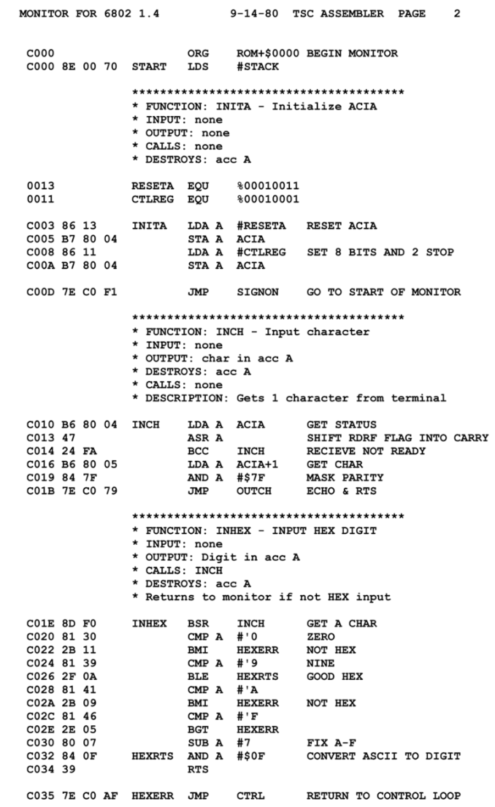
1949
The low-level language Assembly was born. It has a very strong correspondence between the instructions in the language and the architecture's machine code instructions.

Slide 7
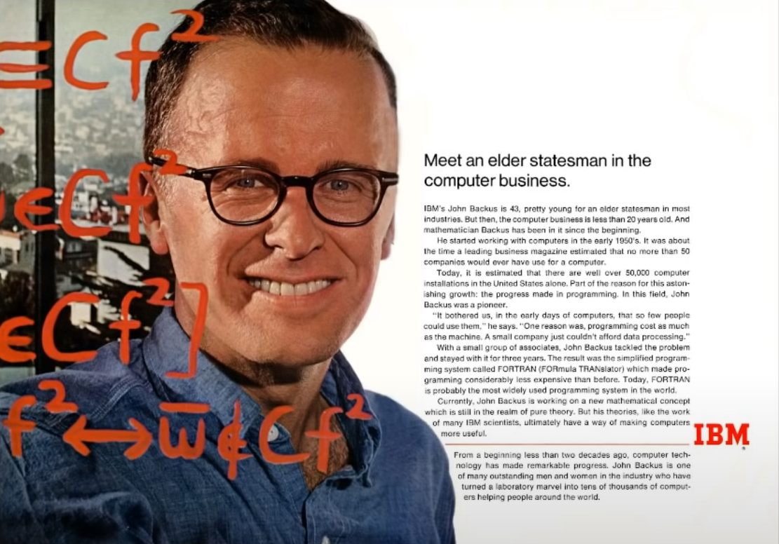
1954
IBM created the first high level programming language FORTRAN (FORmula TRANslation).

Slide 8
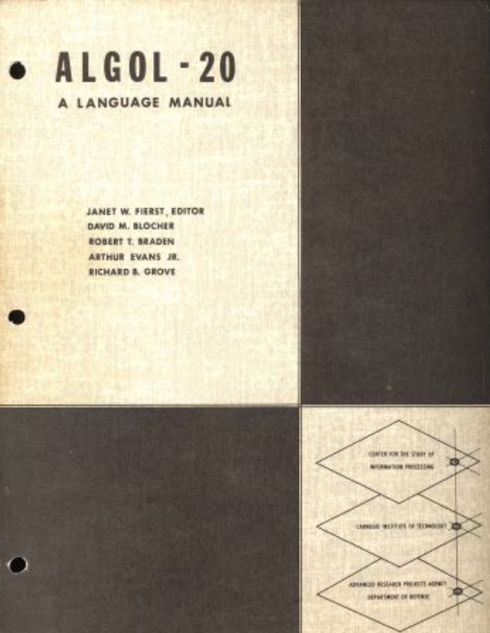
1958
ALGOL (Algorithmic Language) heavily influenced many other languages and was the standard method for algorithm description.

Slide 9
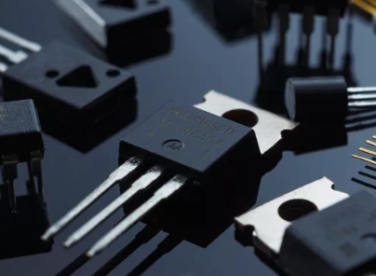
1950s and 1960s
Transistors and Integrated Circuits (IC) were invented.

Slide 10
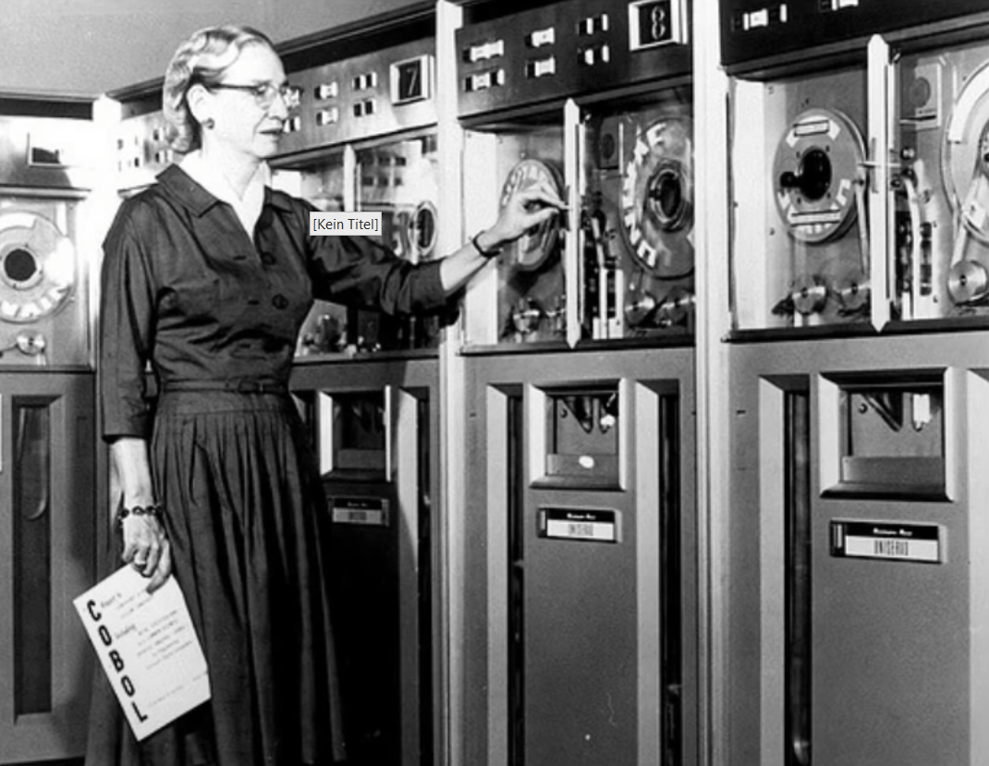
1959
From 1959 to 1961 the language COBOL was created by Grace Hopper. It was the first user-friendly business computer software.

Slide 11
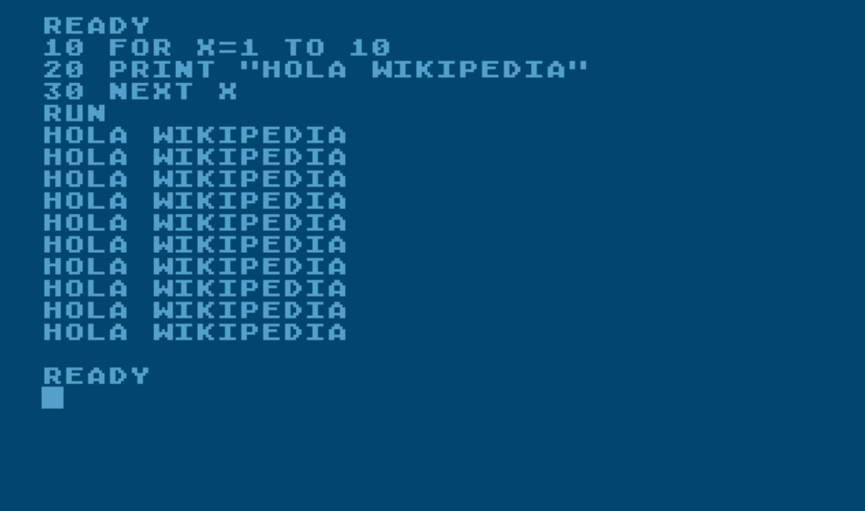
1964
BASIC (Beginner‘s All-purpose Instruction Code). The original version was created by John G. Kemeny and Thomas E. Kurtz at Dartmouth College. They wanted to enable students in non-scientific fields to use computers.

Slide 12
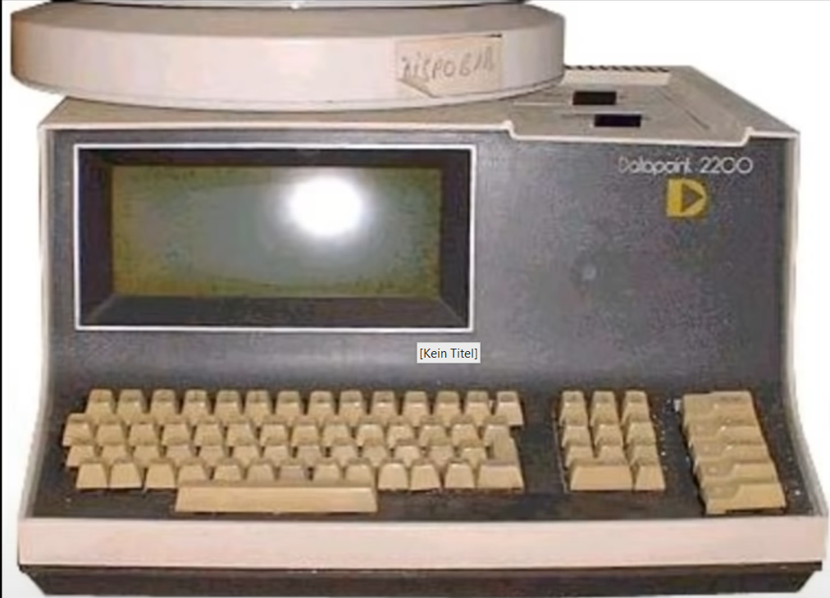
1970
The first personal computers appear.

Slide 13
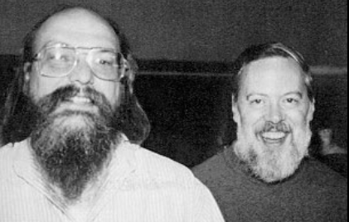
1972
C is a general-purpose computer programming language. It was created in the 1970s by Dennis Ritchie.

Slide 14
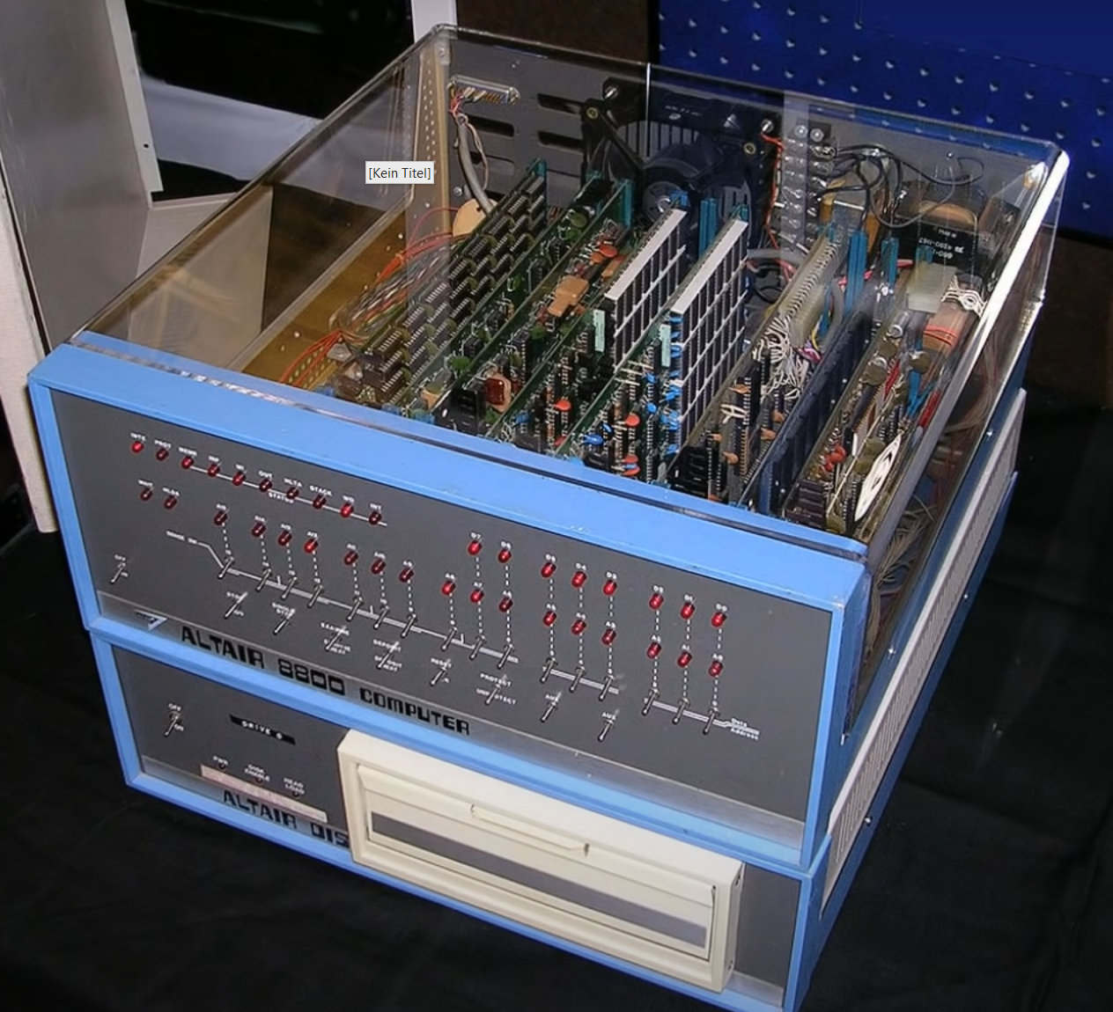
1975
The Altair 8800 was the world‘s first minicomputer kit that was capable of common tasks.
Bill Gates and Paul Allen used to write software on this.

Slide 15
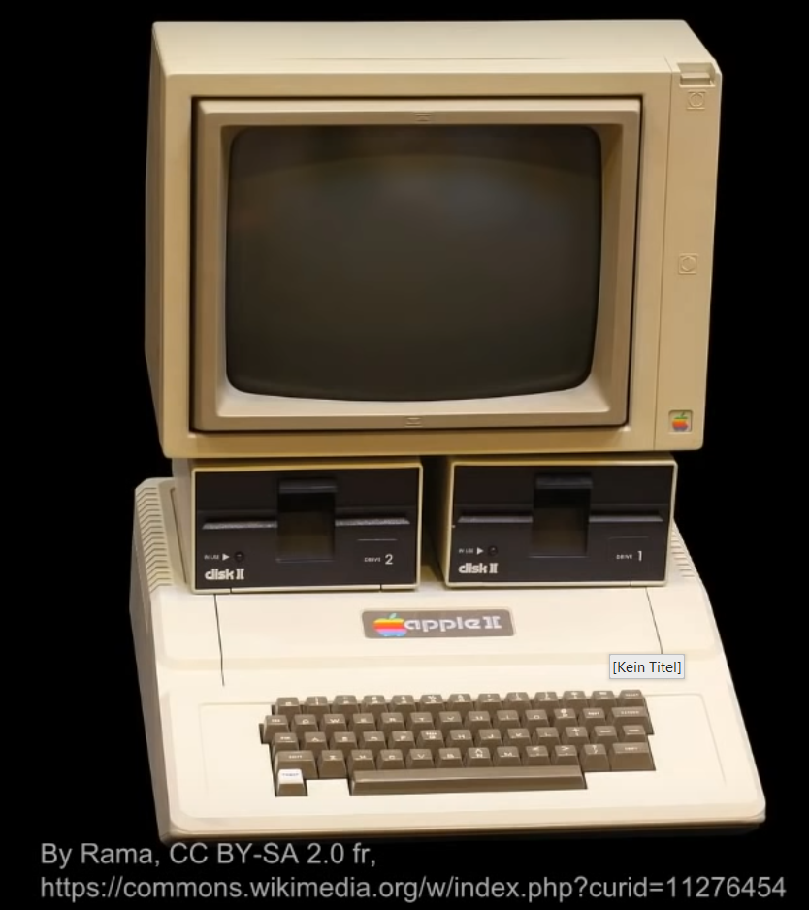
1976
Steve Jobs and Steve Wozniak started Apple Computers with the Apple I.

Slide 16
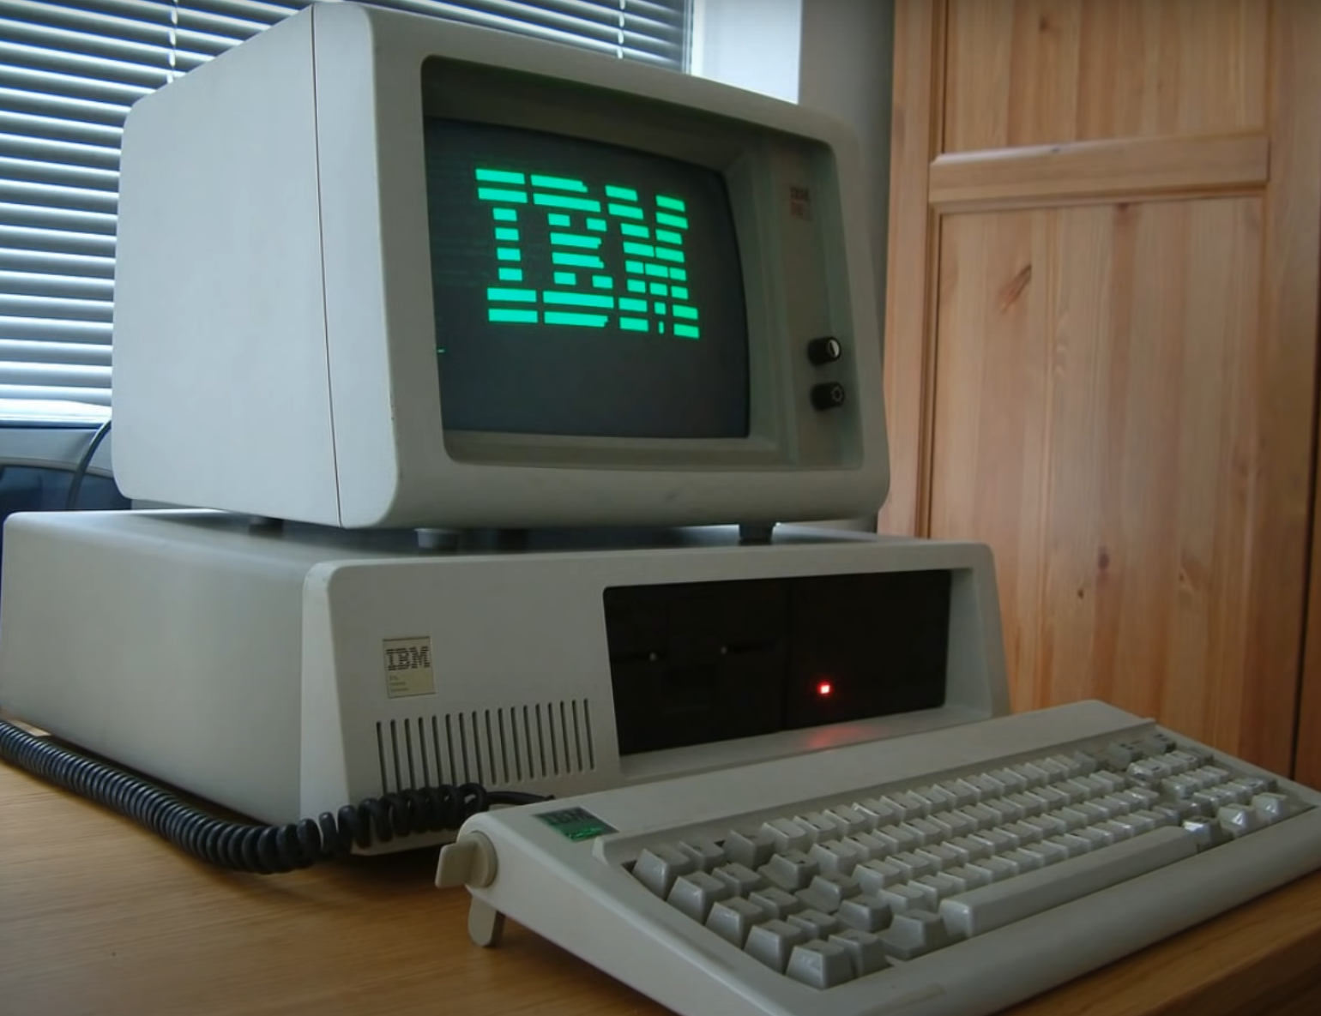
1981
The first IBM PC (5150) with an Intel processor and Microsoft‘s MS-DOS operating system.

Slide 17
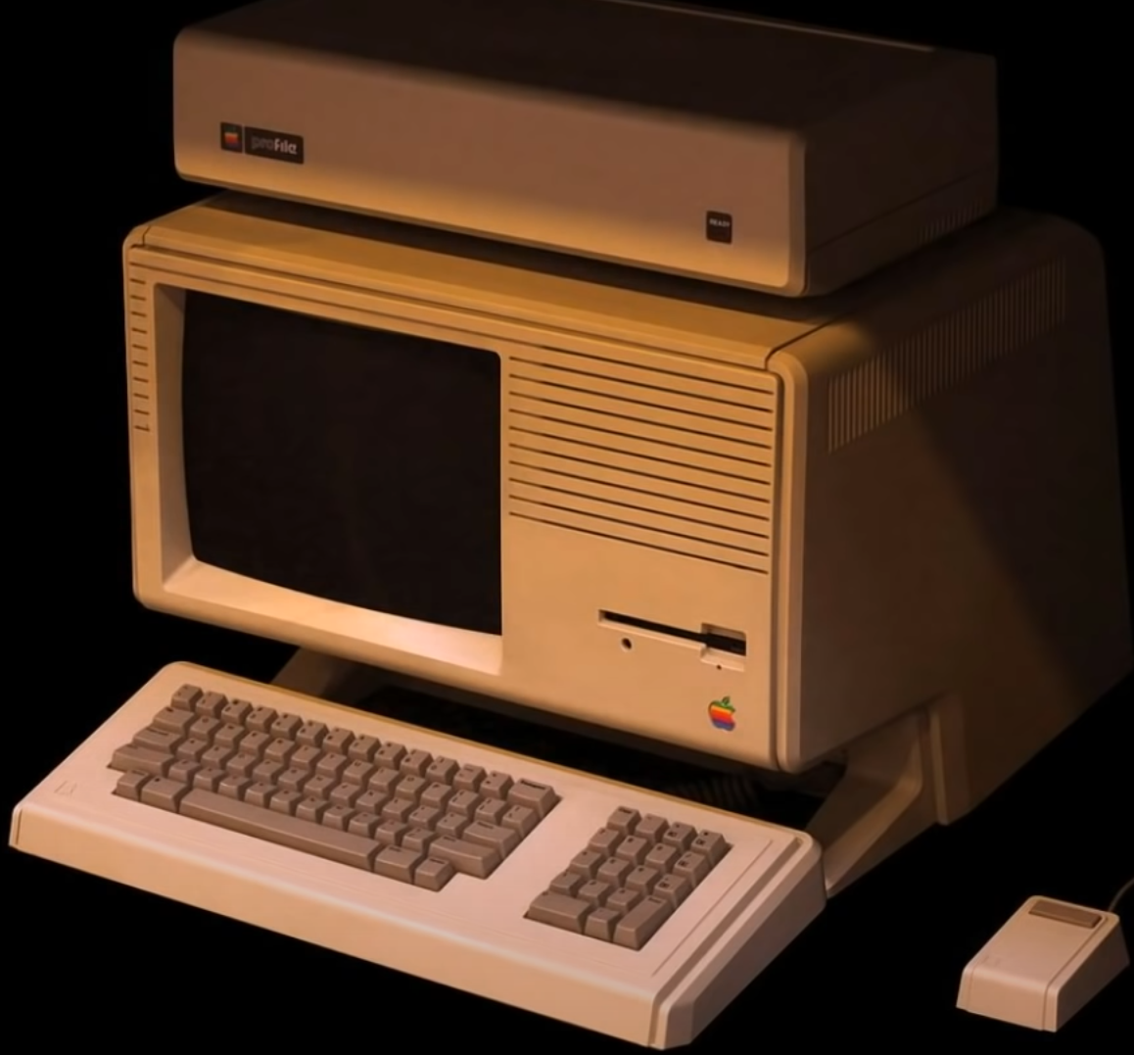
1983
Apple‘s Lisa Computer was the first with GUI and the usage of a mouse.

Slide 18
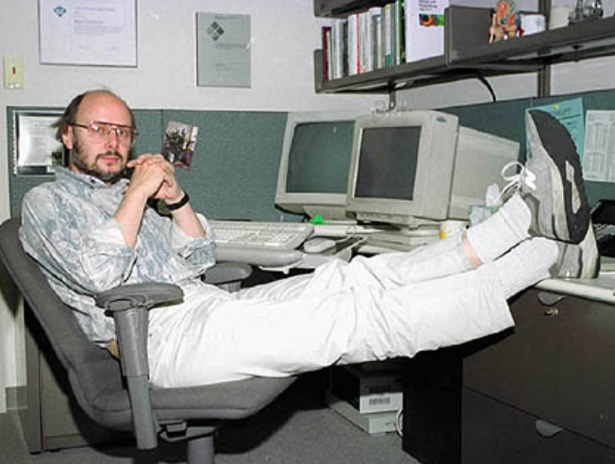
1983
C++, created by Bjarne Stroustrup, is an extension of the C programming language. The language has object-oriented, generic, and functional features in addition to facilities for low-level memory manipulation

Slide 19
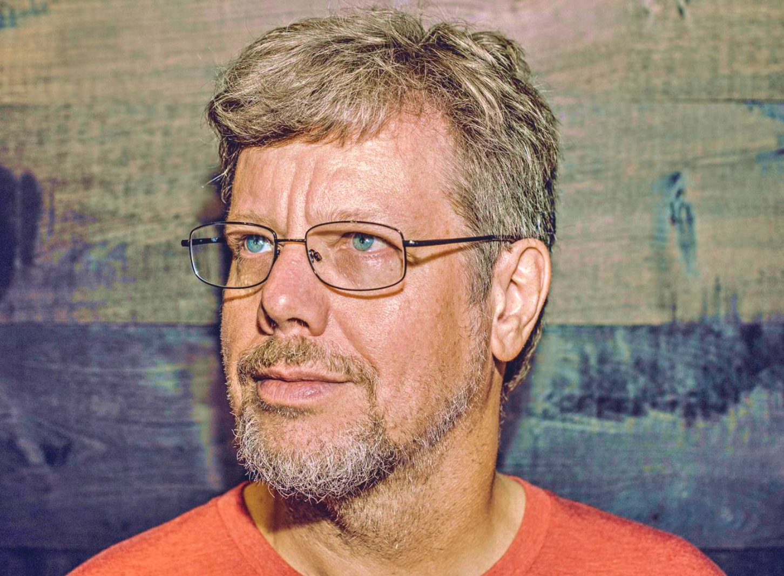
1991
Python, invented by Guido van Rossum, is a high-level, interpreted, general-purpose programming language. Its design philosophy emphasizes code readability with the use of significant indentation.

Slide 20
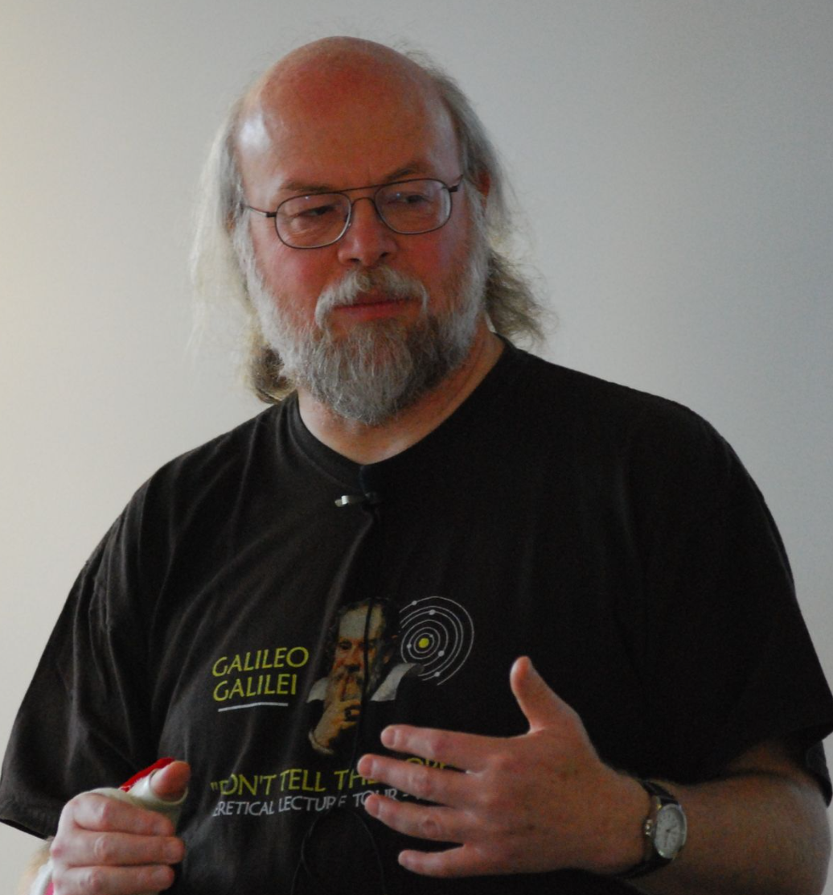
1995
Java, created by James Gosling, is a high-level, class-based, object-oriented programming language. It is a general-purpose programming language intended to let programmers write once, run anywhere.

Slide 21
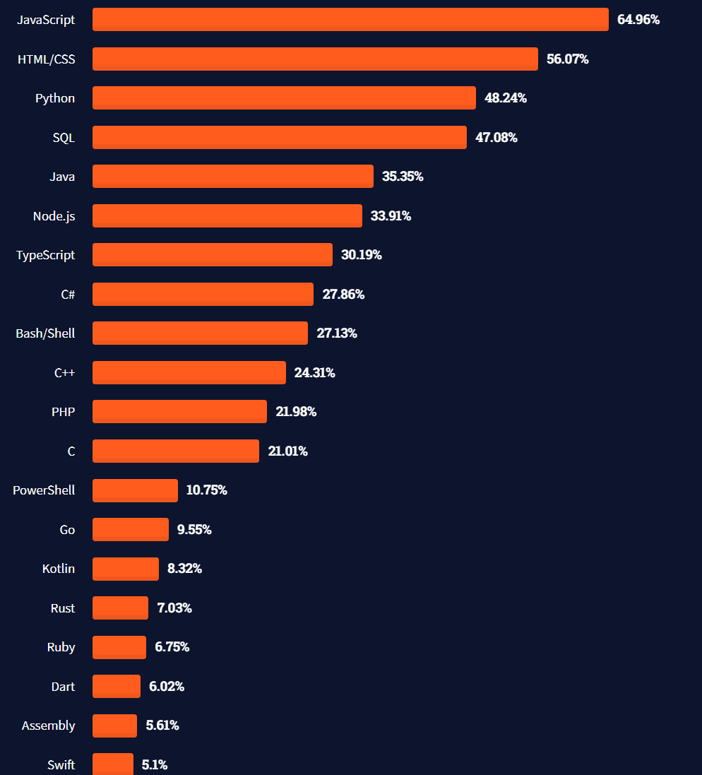
Most used languages

Slide 22
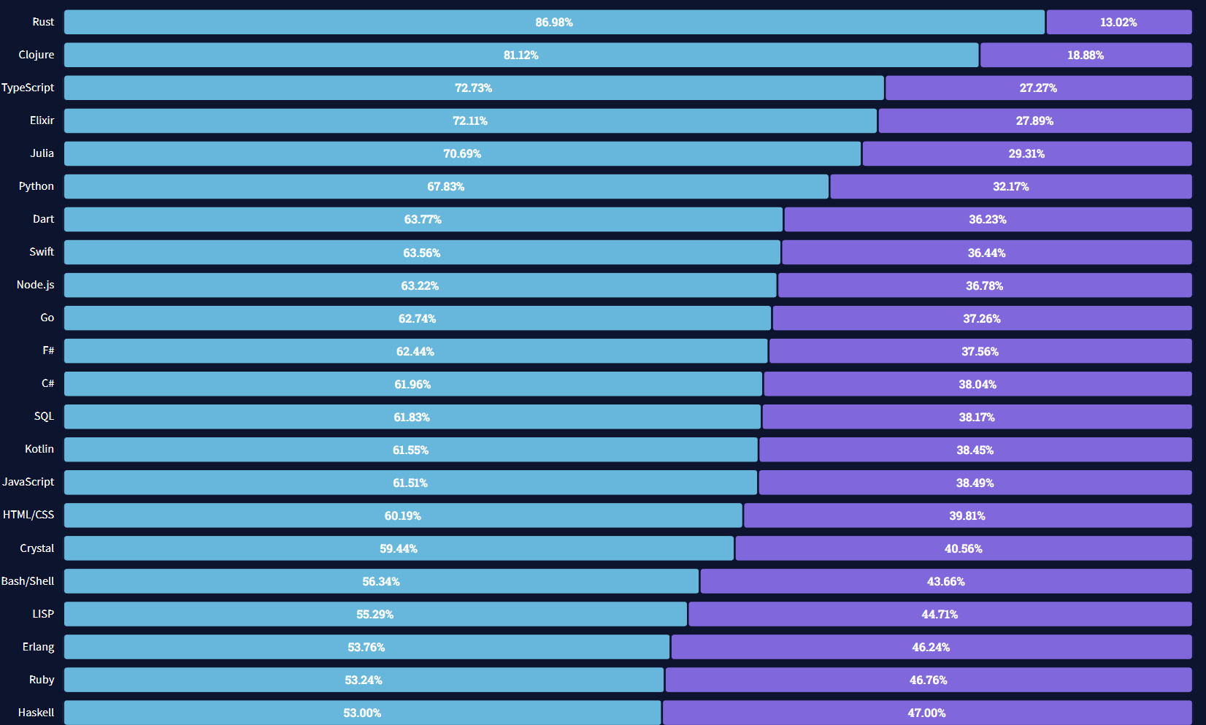
Most loved languages

Slide 23
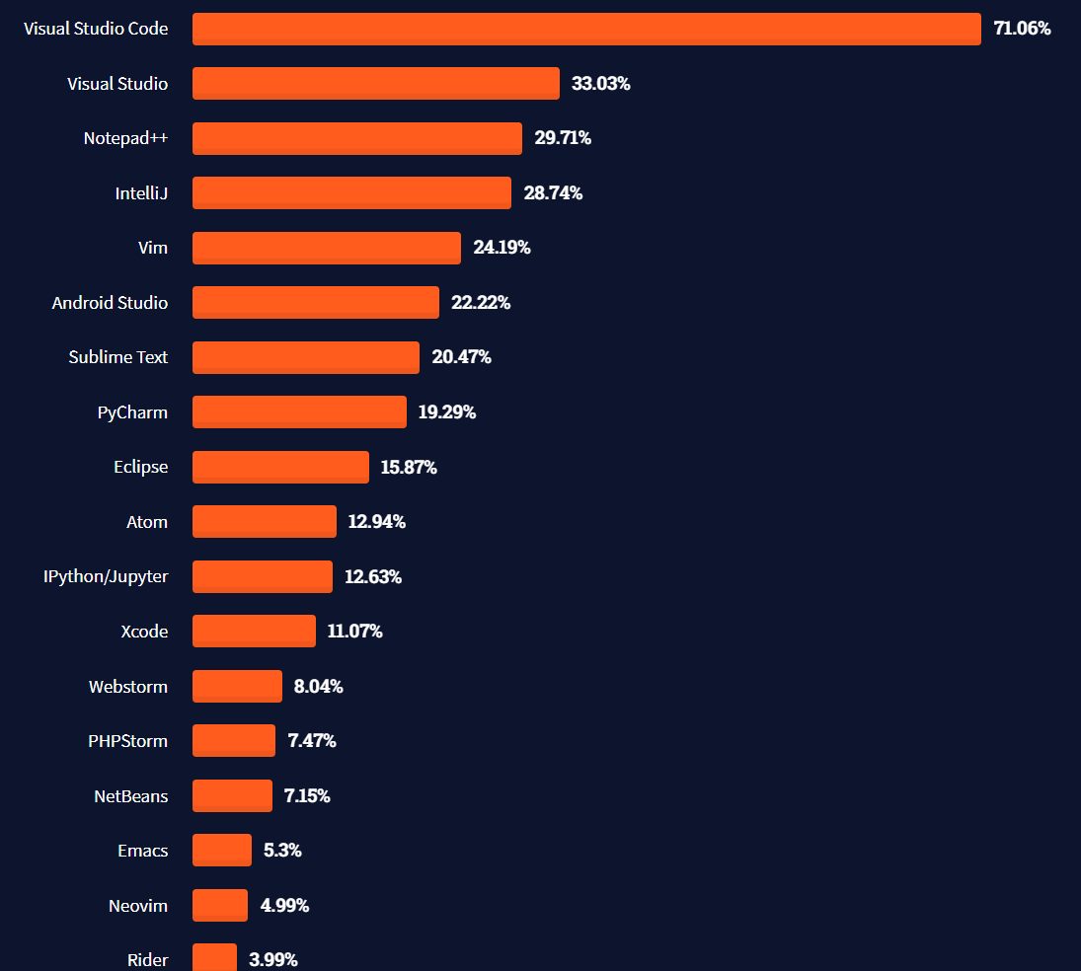
Most used editors

